Slide 1
Programming 4
10.2 Finite State Machines
Semester 2, 2019

Slide 2
FSM: state, actions and events
States and events
Sleeping
Neighbour cat in yard
Becomes
hungry
Neighbour
Cat gone
Full
Eating
Chasing neighbour cat
Notes:
The next technique up. We will build one of these systems next week
This approach requires describing the behaviour of an entity in terms of states, actions and events.
NB: The diagram shows only the states and events. The Actions are included in an additional table that has a column for State and a column for Action. Seen next slide
If the behaviour can be captured this way, there is a good structured technique for coding it up
Example: This is a diagram describing the behaviour of my cat Eddie
Usually, my cat is in the sleeping state. His actions there are sleeping, drooling and occasionally rolling over
If a neighbour cat enters the yard, my cat will sense it. This is an event and causes him to change state
He changes to the Chasing Neighbour Cat state. His actions in this state are targeting the neighbour cat (like the Approachers did with Blobbo), and hissing
When the neighbour cat is gone, he returns to the sleep state
In the sleep state, he can become hungry. This event might occur every 15 minutes of being in the sleep state. This event would move him into the Eating state
And so on
This type of diagram is an example of a construct used in many areas of computer science and mathematics. It is called a Finite State Machine
Note that the details of the actions associated with a state are not included in the diagram, but are inferred
FSMs can be used to describe fairly complex behaviour, and they are easy to code. Think about how you would code my cat…

Slide 3
FSM: state, actions and events
Actions
When in state... | Action...
Sleeping | Lie down with eyes closed Drool Roll over with ROLL_PROB Update Hunger
Chasing | OrientTo(NeighbourCat) Move Hiss
Eating | Gobble food Update Fullness
Notes:
NB. Note that here there is nothing about changing state
This is just what you do while in a particular state

Slide 4
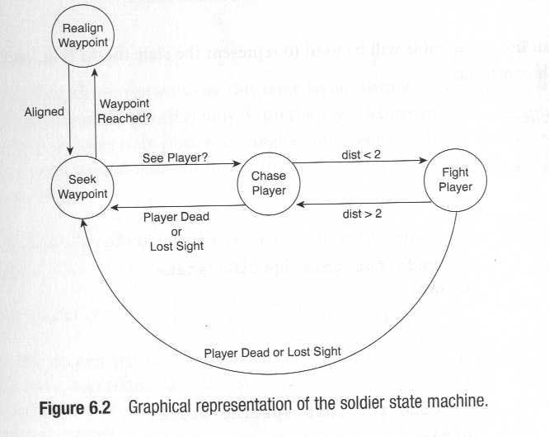
FSM in games
Notes:
The FSM is very common in games programming, because many of the required behaviours can easily be captured using the states-events-actions approach
Here is an FSM for a patrolling guard AI
From Dalmau, Core Techniques and Algorithms in Game Programming
The enemy has a predefined set of waypoints that he patrols in a cyclical way
The enemy detects the player when it is inside his “viewing cone” (field of vision)
If enemy sees player, it chases
If enemy gets close enough to player, he stops chasing and starts hitting
Most of the time in Seek Waypoint, walking toward waypoint
When waypoint reached, turns toward next waypoint
When realigned, returns to Seek state
If while Seeking, see player, moves to Chase state
And so on.

Slide 5
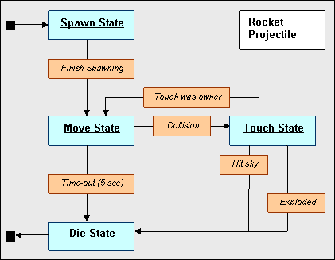
FSM in games
Notes:
Real FSM From Quake
Quake is pretty much all FSM

Slide 6
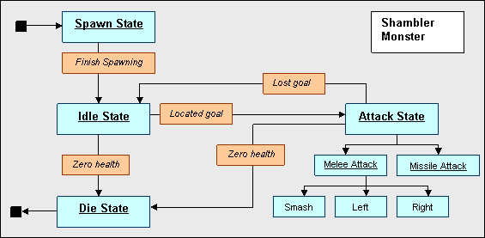
FSM in games
Notes:
From Quake again

Slide 7
FSM in games
Quake II NPCs have nine states:
Standing
Walking
Running
Dodging
Attacking
Melee
Seeing the enemy
Idle
Searching

Slide 8
Coding an FSM
To code an FSM, you need two primary methods:
Update state
Perform actions
Notes:
The update state method says: Given the state I am currently in, check for each of the events that cause me to change state. If one has occurred, change
The perform actions method says: Given the state I am currently in, do whatever actions are associated with being in that state
At each game cycle, all AIs do their update state. Then all AIs do their perform actions
In practice, a managing class like a sprite list, or something that holds an array of entities, iterates over its collection and calls the methods on each one. All update, then all action

Slide 9
Coding an FSM
Update state
switch (catState)
case Sleeping:
if (cat in yard)
CatState = Chasing;
else if (has not eaten for 15 minutes)
CatState = Eating;
Break;
case Chasing:
if (neighbour cat gone)
CatState = Sleeping;
break;
…..
Notes:
Both of these methods are built on one big switch statement
NB: In this method, we only make sure we are in the correct state. We don’t do anything
In pseudocode, it looks like this (for my cat)
Then the bulk of the coding is to be able to keep track of things like how long since you have eaten (use counter variables) and whether there is another cat in the yard (write methods that accept a collection of neighbour cats and check their locations)

Slide 10
Coding an FSM
Perform actions
switch (catState)
case Sleeping:
Drool();
if (rGen->Next(100) > ROLLPROB) Rollover();
Haven’tEatenCount++
break;
case Chasing:
TargetAction(NeighbourCat);
Hiss();
break;
…..
Notes:
Here are all the things one does in each state
It is important when coding an FSM to keep quite clear what is an event that changes state and what is an action while in a state. Don’t mix them up. Don’t, for example, put actions in the UpdateState method. That will make your code much harder to maintain than if you keep the two types of code clearly separated
And so on. You need to figure out how to implement all the behaviours, but the scheduling code is quite straightforward

Slide 11
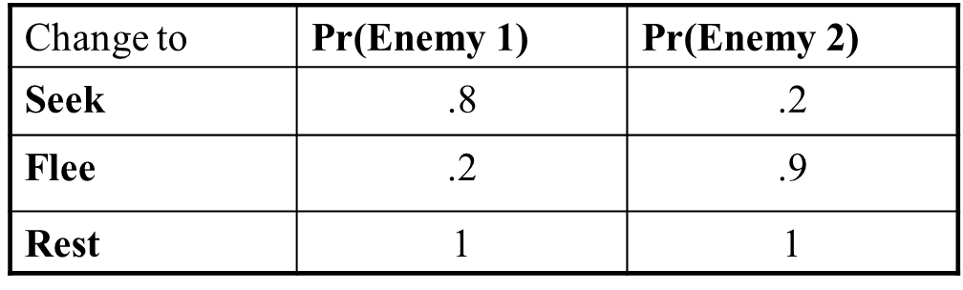
Probabilistic FSM
Seek
Flee
Rest
Notes:
We can extend the FSM to make the behaviours more interesting, and more useful for game play, by adding some stochasticity
In our discussion so far, a given event always triggered a particular state change. More realistic behaviours can be achieved by adding a stochastic component
That is, event E will cause change to state S with probability P (in our previous examples, P was always 1)
By adjusting the probability distributions, you can get different behaviours from the same FSM
Enemy 1 would be very aggressive, and enemy 2 would be very passive

Slide 12
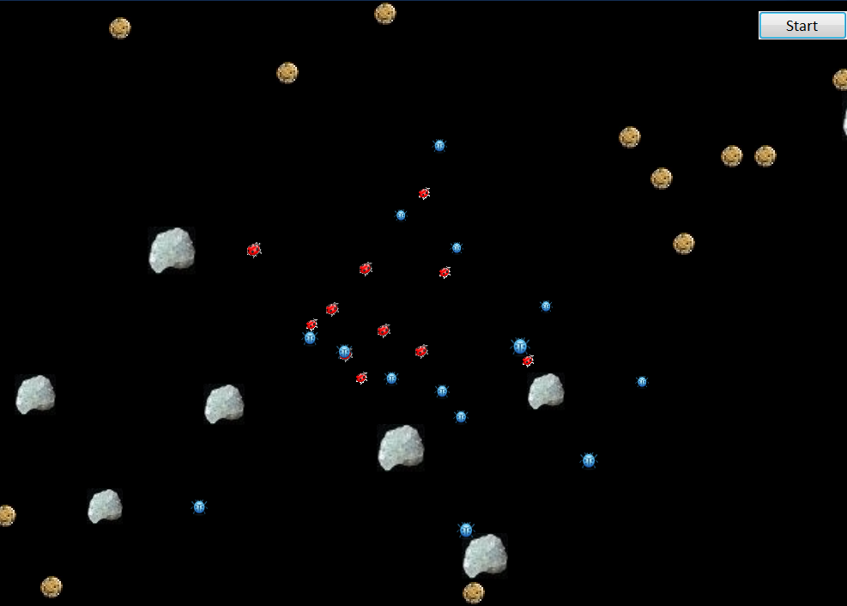
Practical

